Slide 1
Time Series Unit 7
Forecasting

Slide 2
Quarterly Data
Check out page 218 in the text. Discuss what you think is meant by “it is often the case that s = 4 (for quarterly data) and s = 12 for (monthly data).”

Slide 3
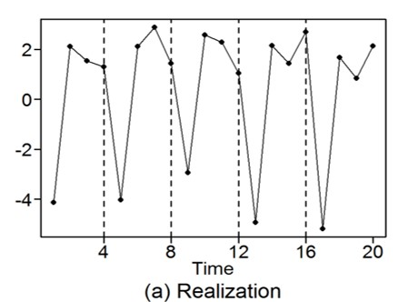
i.e.
Etc.
For quarterly sales data, this model says that sales in the current quarter are equal to the sales for this quarter last year plus a random-noise term.

Slide 4
First:
(simple factoring)
Notes:
Keep as slide? Maybe add a Lightboard as well?

Slide 5
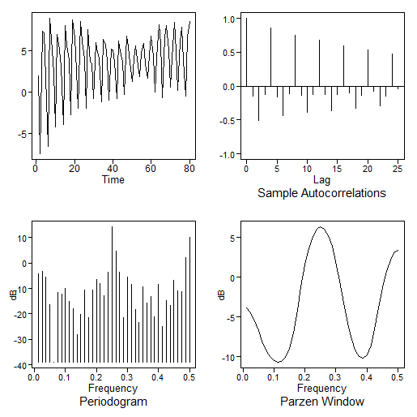
Notes about the models:
“Quarterly” behavior is present in realization (but not as clear as it was in the initial realization of length n = 20).
Sample autocorrelations at lags 4, 8,… are “large,” which is consistent with the model.
That is, X_{t}, X_{t+4}, X_{t+8},… would be expected to be “similar.”
The spectral estimate has peaks at f = 0, .25, and .5 (we’ll come back to this).
$$\left(1−B^{4}\right)=(1−B)(1+B^{2})(1+B)$$

Slide 6
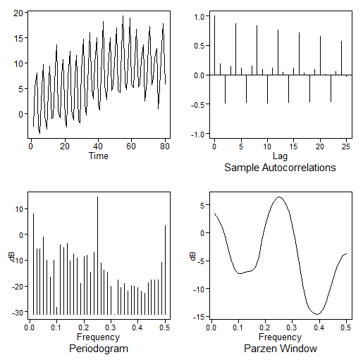
Notes about the models:
“Quarterly” behavior (seasonal behavior at lag 4) is present in realization.
Sample autocorrelations at lags 4, 8,… are “large.”
The spectral estimate has peaks at f = 0, .25, and .5).

Slide 7
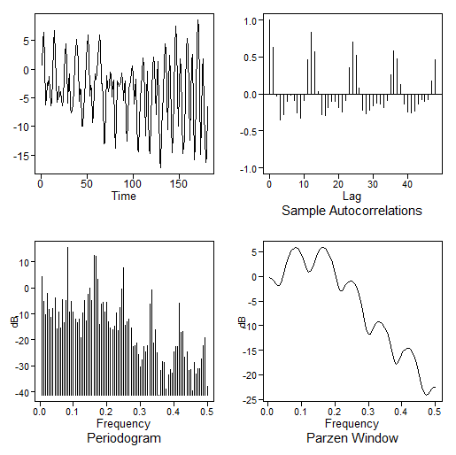
Notes about the models:
“Monthly” (seasonal behavior at lag 12) behavior is present in realization.
Sample autocorrelations at lags 12, 24,… are “large.”
The spectral estimate has mild peaks at f = 0 and .5 along with 5 fairly equally spaced peaks between 0 and .5 (we’ll come back to this shortly).

Slide 8
Break Out 1

Slide 9
Question:
Assume you have data that is recorded monthly that you think could be appropriately modeled with an ARIMA(0,0,0) and s = 4.
What would be the mathematical form of the model?
Describe what the model is saying about the data … about the correlation.

Slide 10
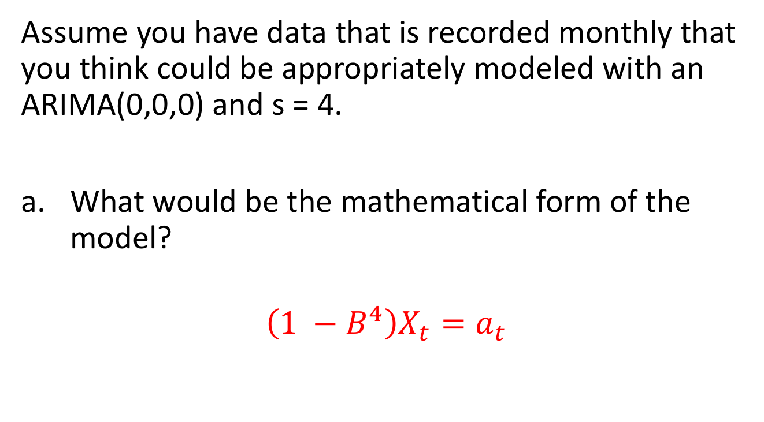
Question:
Assume you have data that is recorded monthly that you think could be appropriately modeled with an ARIMA(0,0,0) and s = 4.
What would be the mathematical form of the model?
$$\left(1 −B^{4}\right)X_{t}=a_{t}$$

Slide 11
Monthy Data With S = 4
Jan Feb Mar Apr May June July Aug Sept Oct Nov Dec
Jan Feb Mar Apr May June July Aug Sept Oct Nov Dec
Jan Feb Mar Apr May June July Aug Sept Oct Nov Dec
Jan Feb Mar Apr May June July Aug Sept Oct Nov Dec
Jan Feb Mar Apr May June July Aug Sept Oct Nov Dec

Slide 12
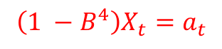
Question:
Assume you have data that is recorded monthly that you think could be appropriately modeled with an ARIMA(0,0,0) and s = 4.
What would be the mathematical form of the model?
Describe what the model is saying about the data … about the correlation.
$$\left(1 −B^{4}\right)X_{t}=a_{t}$$
Each month is correlated with the month that is four months previous. The model has pseudo periodic behavior of 4 months.

Slide 13
End Break Out 1

Slide 14
Break Out 2

Slide 15
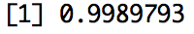
ACF of (1-B)X_{t} = a_{t}
a = gen.aruma.wge(5000,d = 1, vara = 1, sn = 6)
plotts.sample.wge(a)
plot(a[1:4999],a[2:5000], xlab = "X_t-1", ylab = "X_t", main = "Plot of X_t vs. X_t-1")
cor(a[1:4999],a[2:5000])

Slide 16
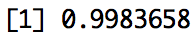
ACF of (1-B⁴)X_{t} = a_{t}
a = gen.aruma.wge(5000,s = 4,vara = 100, sn = 6)
plotts.sample.wge(a)
plot(a[1:4996],a[5:5000], xlab = "X_t-4", ylab = "X_t", main = "Plot of X_t vs. X_t-4")
cor(a[1:4996],a[5:5000])

Slide 17
End Break Out 2

Slide 18
Break Out 3

Slide 19
Review and Describe Your Realization
Remind your group about your realization
Topic
Scale
ACF / Spectral Density
Describe which model structure you speculate would be appropriate and/or not appropriate for your realization.
Ask any questions you might have about your or anyone else’s realization / model choice in your group.

Slide 20
End Break Out 3

Slide 21
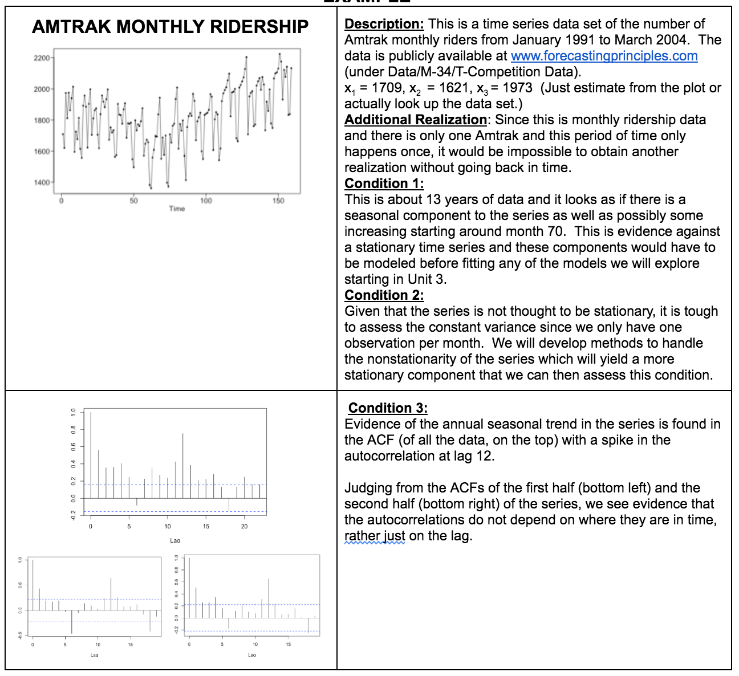
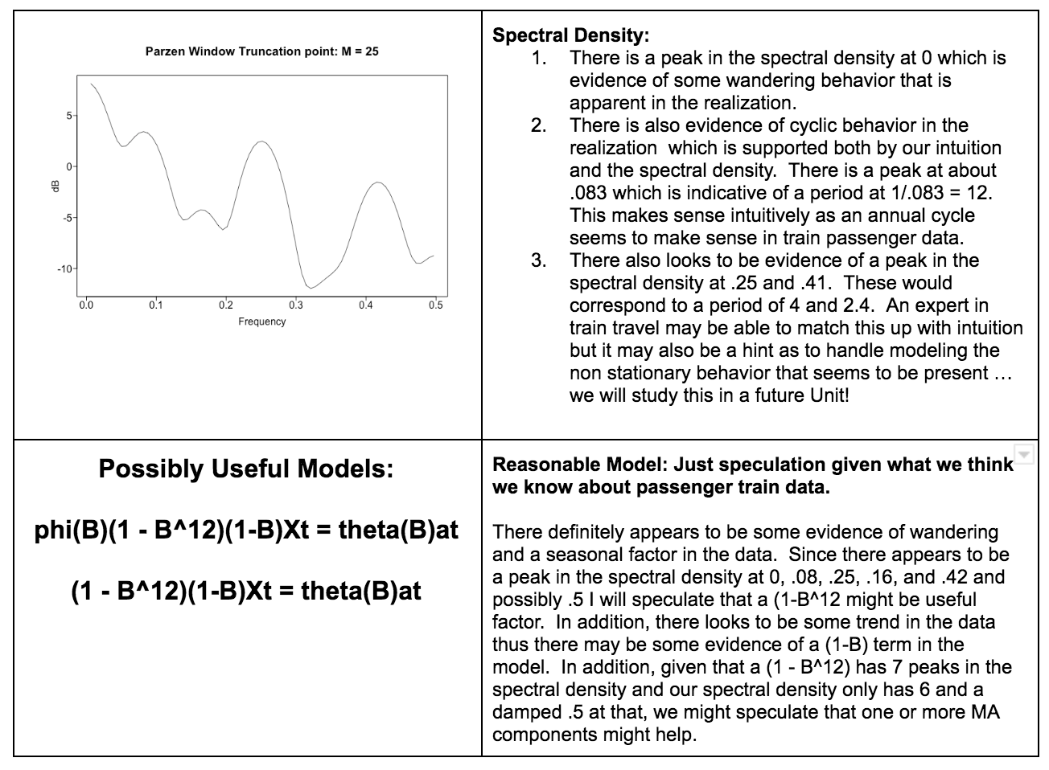
Amtrak

Slide 22
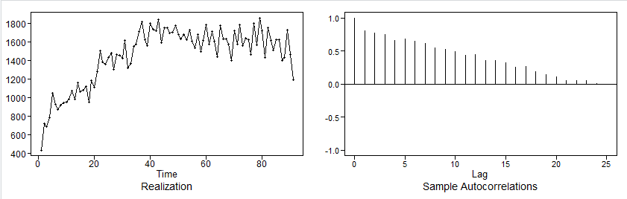
1.) Which model do you think is appropriate to use to forecast your time series?
Recall the time series and sample ACF.
Per the lecture notes, the damping pattern seen in the autocorrelations is a hint that an ARIMA model may be appropriate. I do not see strong evidence of seasonality in this model.
Additionally, I examined periods 40 – 91 since that appears to be the time when there was an operating change. Examining this time period’s ACF also did not reveal strong seasonality. Per the unit 6 assignment, the model structure I propose is (3,2). This was evidence of this structure in the AIC5.

Slide 23
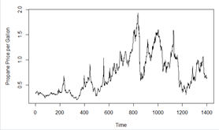
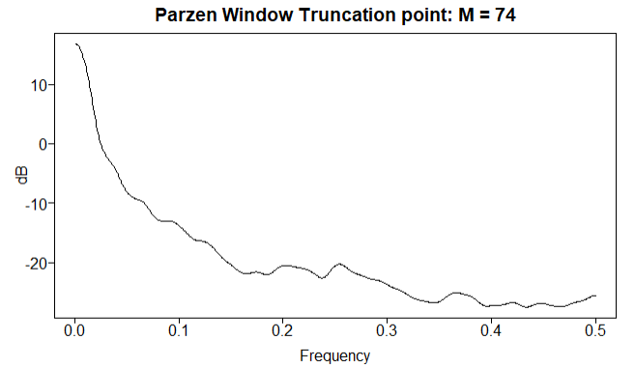
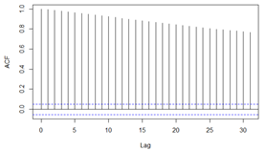
Q1
Which model do you think is appropriate to use to forecast your time series? Why?
This is a time series data set of the number of weekly Mont Belviue, TX propane prices per gallon from July 1992 to April 2019. This is about 27 years of data and there is not enough evidence for a seasonal component looking at the spectral density plot. Positive autocorrelation is seen with the autocorrelation plot so the series does not appear the be stationary.
Due to the non-stationary characteristics of this series, an ARIMA model is probably the best model to use.

Slide 24
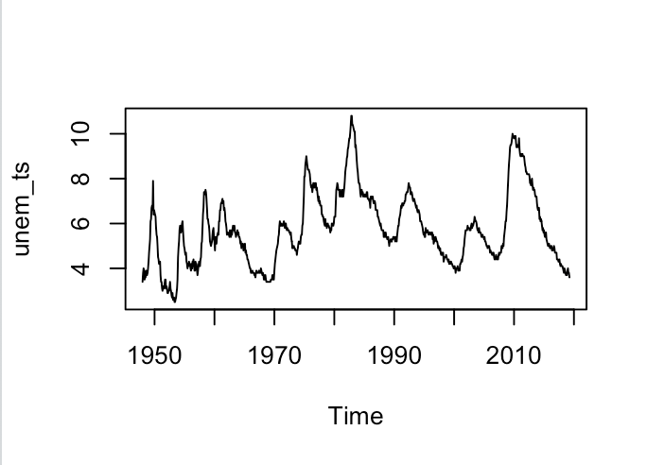
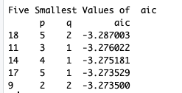
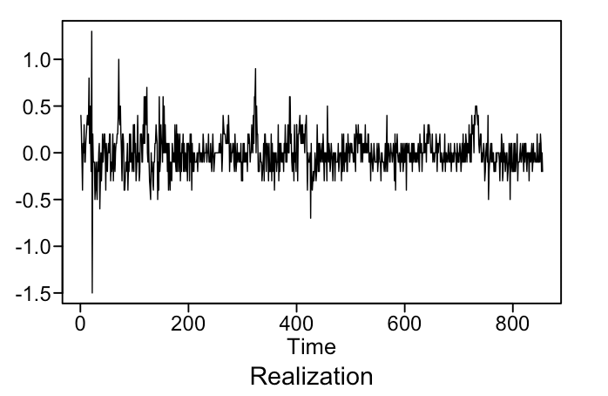
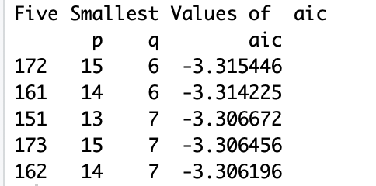
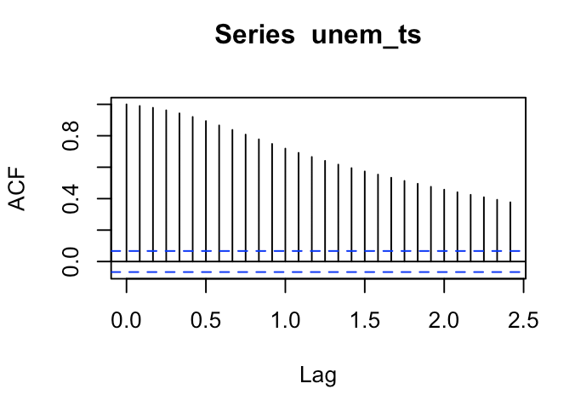
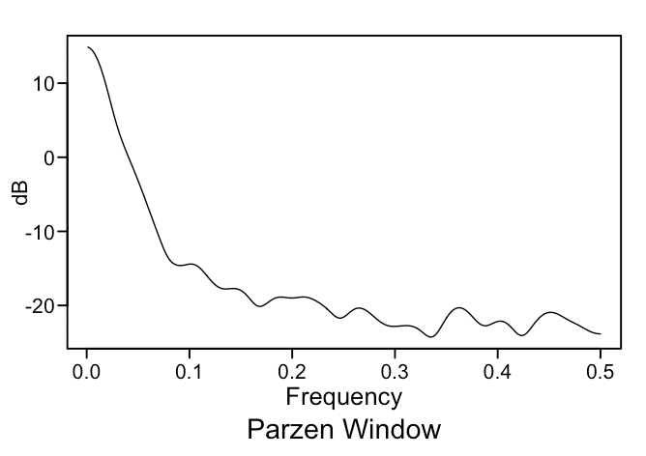
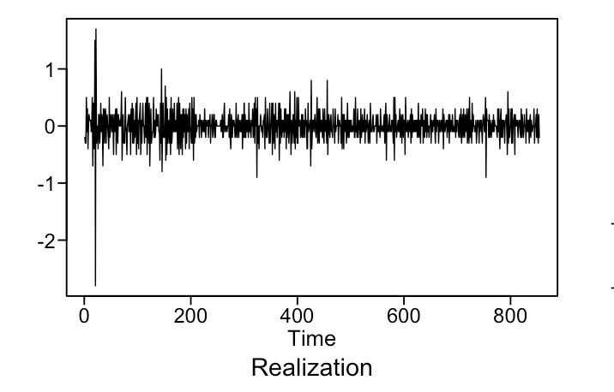
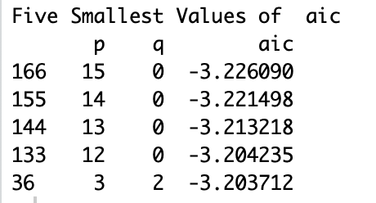
Model Discussion for First Day Time Series:
Original Realization:
Differenced Realization (1st and 2nd):
1st Difference:
2nd Difference:
Discussion:
Previous analysis demonstrated the presence of multiple AR and MA factors in this model. There does not appear to be a deterministic signal present in the realization, so a Signal-Plus noise model does not seem to be an appropriate representation of this Time Series. Seasonal trends are also difficult to determine in this Time Series. At present, I would rule out an ARUMA model. However, when a first difference model is analyzed, the realization that is observed is fairly representative of white noise (minus the variance in the initial observations). This evidence would suggest the selection of an ARIMA model with a differencing term of 1, possibly even 2, might be most appropriate for modeling US monthly unemployment data.

Slide 25
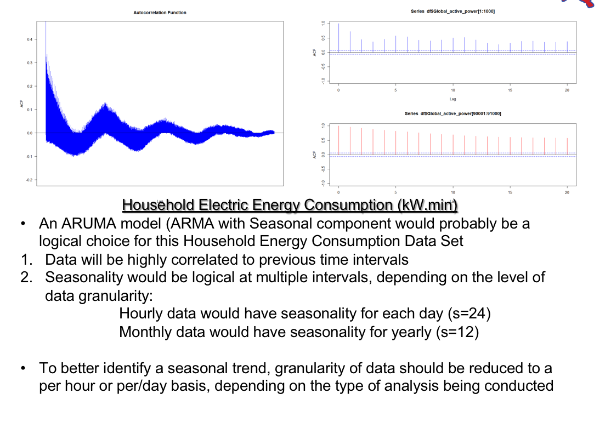

Slide 26
Break Out 4

Slide 27
Question 2

Slide 29
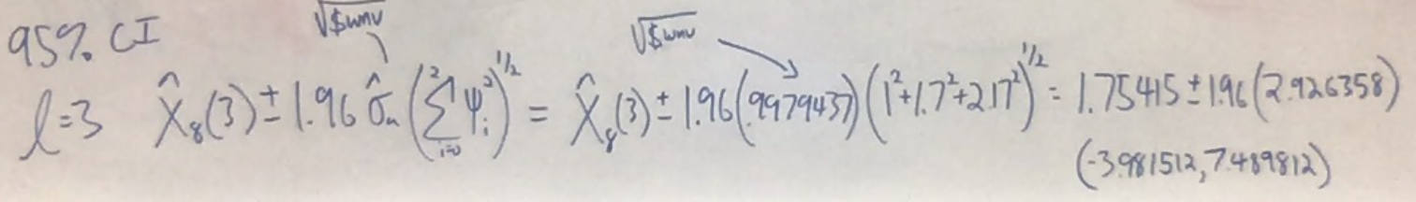

Slide 30
R Code for Question 2 (To verify)
#(1-.9B)(1-.8B)Xt = at
#(1-1.7B+.72B^2)Xt = at
#Phi_1 = 1.7 Phi_2 = -.72
s = c(5,8,9,8,7,6,4,3)
#double check psi weights
psi.weights.wge(phi = c(1.7, -.72), lag = 5)
#AR(2)
fit = fore.arma.wge(s,phi = c(1.7, -.72), n.ahead = 3)
#forecasts for l = 1,2 and 3
fit$f
#Conf limits for l = 3
# ll: 1.75415 - 1.96*sqrt(fit$wnv)*sqrt(1+1.7^2+ 2.17^2)
# ul: 1.75415 + 1.96*sqrt(fit$wnv)*sqrt(1+1.7^2+ 2.17^2)
fit$ll[3]
fit$ul[3]
#sigma_at_hat
sqrt(fit$wnv)
#Calc sigma_at_hat
wnv = 1/(8-2) * sum(fit$resid[3:8]^2)

Slide 31
End Break Out 4

Slide 32
Break Out 5

Slide 33
Amtrak Ridership Data (monthly)
amtrak$Ridership #assuming the data has been imported
plotts.sample.wge(amtrak$Ridership)

Slide 34
Taking out (1-B¹²)
aR_12 = artrans.wge(amtrak$Ridership,phi.tr = c(rep(0,11),1))

Slide 35
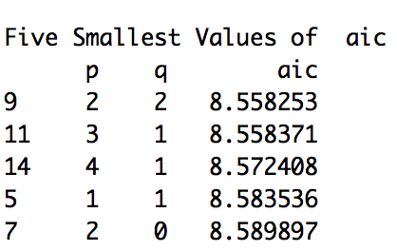
Structure of stationary series after taking out (1-B¹²)
aic5.wge(aR_12)
aR_12 = artrans.wge(amtrak$Ridership,phi.tr = c(rep(0,11),1))

Slide 36
Next step:
aic5.wge(aR_12)
The next step would be to estimate the two phi’s and the two thetas. We will do this in Unit 9 so for now I we will provide them:
#Phis
c(-0.02709541, 0.74213105)
#Thetas
c(-0.5844596, 0.3836931)

Slide 37
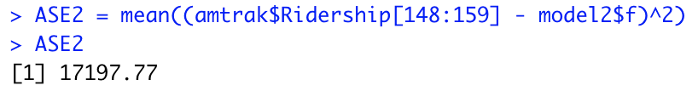
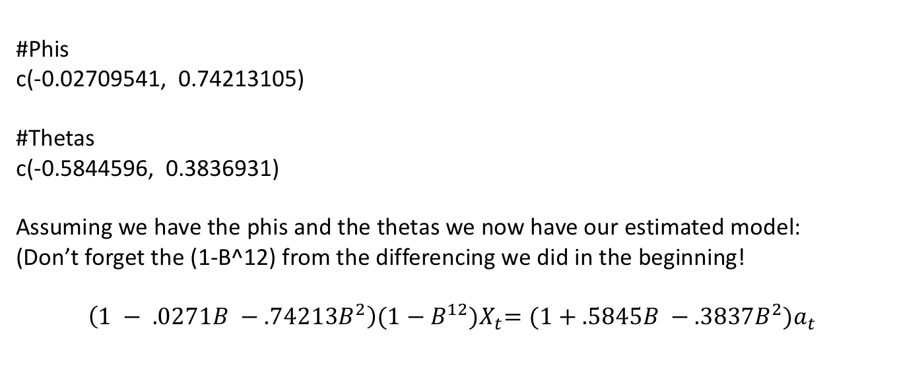
Forecasts
#Phis
c(-0.02709541, 0.74213105)
#Thetas
c(-0.5844596, 0.3836931)
Assuming we have the phis and the thetas we now have our estimated model:
(Don’t forget the (1-B^12) from the differencing we did in the beginning!
$\left(1 − .0271B −.74213B^{2}\right){(1−B^{12})X}_{t}={(1+.5845B −.3837B^{2})a}_{t}$
model2 = fore.aruma.wge(amtrak$Ridership,phi = c(-0.02709541, 0.74213105), theta = c(-0.5844596, 0.3836931), n.ahead = 12,s = 12, lastn = TRUE)

Slide 38
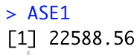
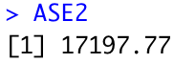
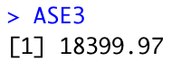
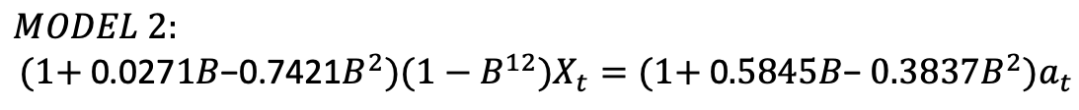
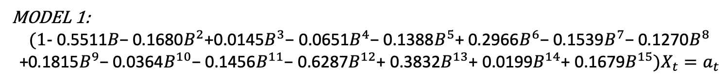
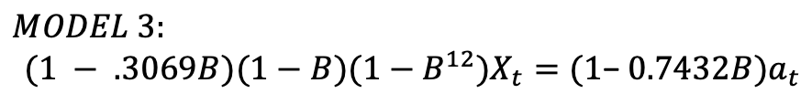
Amtrak: For Live Session Question 3
MODEL 1:
$$(1\text{− }\text{0.5511}B\text{−}\text{ 0.1680}B^{2}\text{+}\text{0.0145}B^{3}\text{− }\text{0.0651}B^{4}\text{− }\text{0.1388}B^{5}\text{+ }\text{0.2966}B^{6}\text{− }\text{0.1539}B^{7}\text{− }\text{0.1270}B^{8}$$
$$\text{+}\text{0.1815}B^{9}\text{− }\text{0.0364}B^{10}\text{− }\text{0.1456}B^{11}\text{− }\text{0.6287}B^{12}\text{+ }\text{0.3832}B^{13}\text{+ }\text{0.0199}B^{14}\text{+ }\text{0.1679}B^{15})X_{t}=a_{t}$$
model1 = fore.arma.wge(amtrak$Ridership,phi = c(0.5511, 0.1680, -0.0145, 0.0651, 0.1388, -0.2966, 0.1539, 0.1270, -0.1815, 0.0364, 0.1456, 0.6287, -0.3832, -0.0199, -0.1679), n.ahead = 12, lastn = TRUE)
ASE1 = mean((amtrak$Ridership[148:159] - model1$f)^2)
$$MODEL 2:$$
$$(1\text{+ }\text{0.027}1B\text{−}\text{0.7421}B^{2})(1−B^{12})X_{t}={(1\text{+ }\text{0}.5845B\text{− }0.3837B^{2})a}_{t}$$
model2 = fore.aruma.wge(amtrak$Ridership,phi = c(-0.02709541, 0.74213105), theta = c(-0.5844596, 0.3836931),
n.ahead = 12,s = 12, lastn = TRUE)
ASE2 = mean((amtrak$Ridership[148:159] - model2$f)^2)
$$MODEL 3:$$
$$(1 − .3069B)(1−B)(1−B^{12})X_{t}={(1\text{− }0.7432B)a}_{t}$$
model3 = fore.aruma.wge(amtrak$Ridership,phi = 0.306943, theta = 0.7431719, n.ahead = 12,s = 12,d = 1, lastn = TRUE)
ASE3 = mean((amtrak$Ridership[148:159] - model3$f)^2)

Slide 39
End Break Out 5

Slide 40
Rolling Window ASE

Slide 41
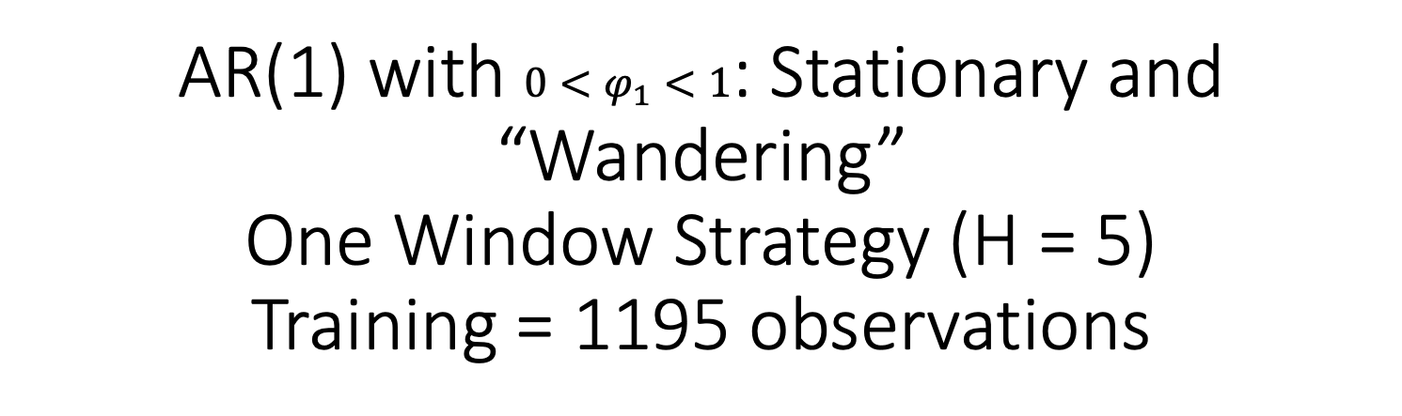
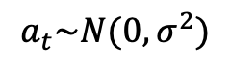

AR(1) with $0<φ_{1}<1$: Stationary and “Wandering” One Window Strategy (H = 5) Training = 1195 observations
1195
5
Training
$X_{t}=.97X_{t−1}+a_{t}$
$$a_{t}\sim N(0,σ^{2})$$
Test

Slide 42
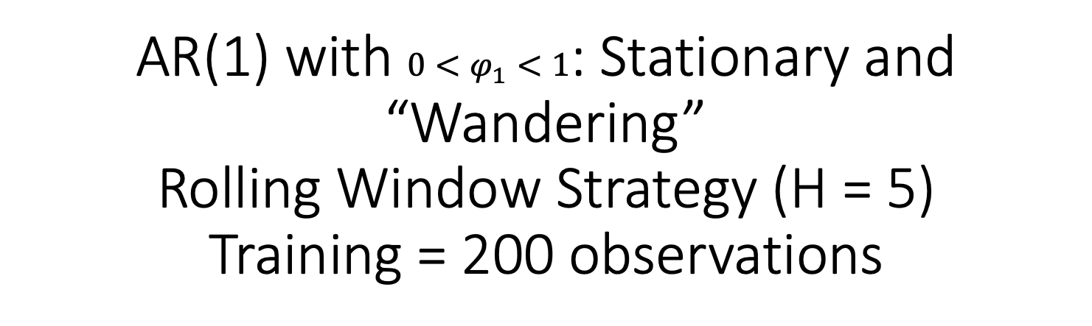
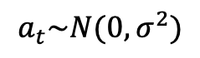

AR(1) with $0<φ_{1}<1$: Stationary and “Wandering” Rolling Window Strategy (H = 5) Training = 200 observations
200
5
200
5
200
5
200
5
200
5
200
5
$$X_{t}=.97X_{t−1}+a_{t}$$
Training
$$a_{t}\sim N(0,σ^{2})$$
Test

Slide 43
CV: Sliding ASE
# Sliding CV ... batches are mutually exclusive
ts = amtrak$Ridership
batch_size = 50
start = 1
num_batches = length(ts)-batch_size+1
ASEs = numeric(num_batches)
for (i in 0: (num_batches-1))
{
forecasts = fore.aruma.wge(ts[start:(batch_size+i)], phi = c(-0.02709541, 0.74213105), theta = c(-0.5844596, 0.3836931), d = 0, s = 12, n.ahead = 12, lastn = TRUE)
ASEs[i+1] = mean((ts[start:(batch_size+1)] - forecasts$f)^2)
start = start+1
}
ASEs
mean(ASEs)
sd(ASEs)

